Slide 1
Project WAYS
Andy O
Ashish N
Johnathan T
Marek M

Slide 2
WAYS ?
Problem statement
Is there a way to understand the consumer surrounding my location?
Can I lookup the demographics based on the location?
Where are my competitors located compared to my own stores?
Answer – WAYS
Wait what is WAYS?
Where Are Your Stores
A service to help your business identify the Optimum Trade Area

Slide 3
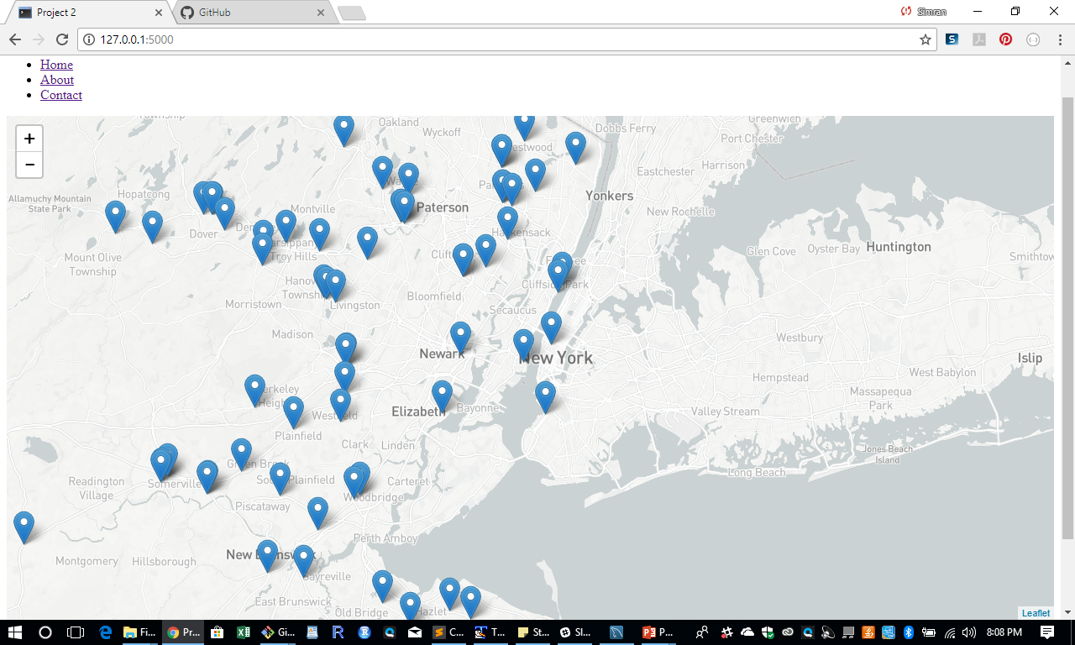
Functionality
Preload the BBB stores on the NJ, CT
Click on a Store (marker)
Enter Trade Area (Miles)
Application will highlight zip codes up to 15 Miles within a circle
On the bottom show demographic distribution by zip code

Slide 4




Toolkit

